Slide 1


Amazon Last Mile Routing
Research Challenge Team
Adam Catalfano, Ishan Kaul, Elena McQuay, Alex Nelson

Slide 2
Challenge Objective
Build a model that uses known delivery data and historically observed high, medium- and low-quality route sequences to propose high-quality route sequences for new deliveries for which no observed route sequence is known yet.

Slide 3
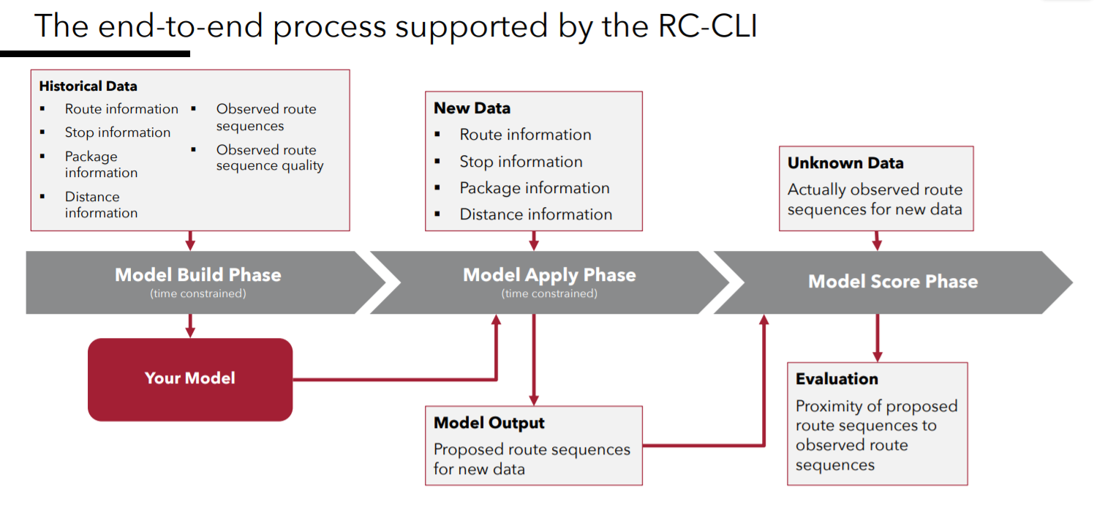
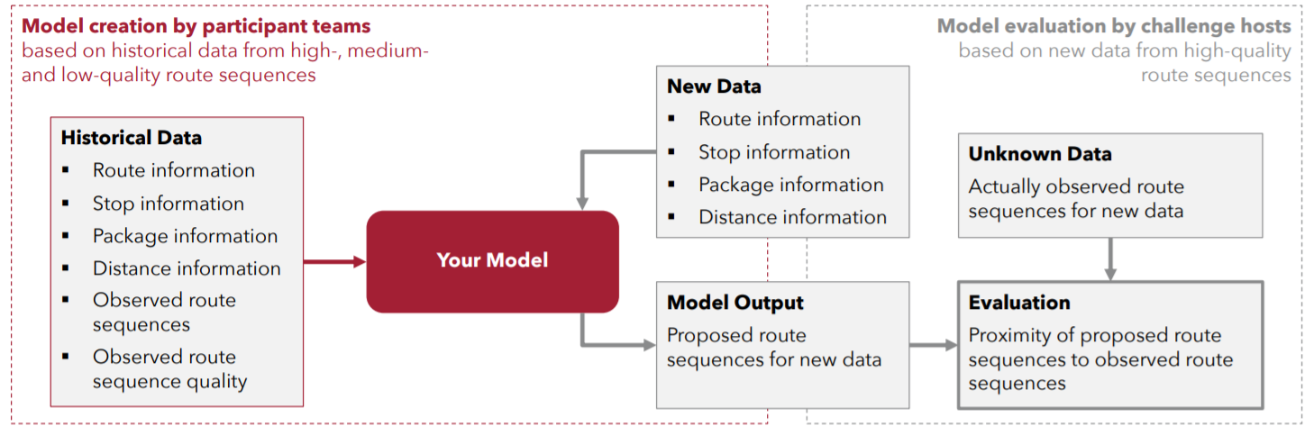

Slide 4
Research Teams
data
Application
Theoretical Approaches

Slide 5
Data Team
Evaluate historical data
Identify patterns and trends

Slide 6
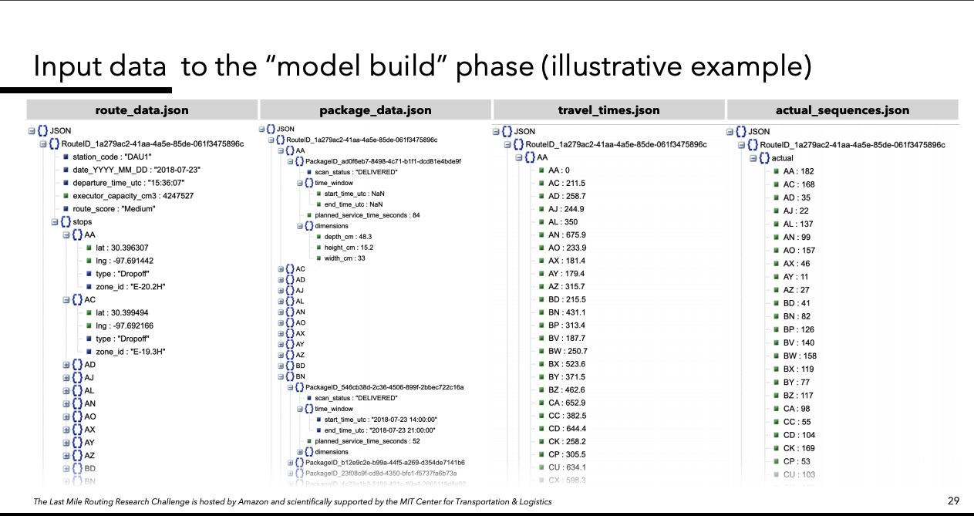

Slide 7
Application Team
Evaluate additional tools to be applied to solution
Review and understand the tools provided by the challenge
Notes:
PyTorch vs. TensorFlow vs Theano
Rc-cli
Scoring system

Slide 8
Application Team
Amazon Provided Tools
Existing ML Frameworks
RC-CLI
Criteria for generating a route score
TensorFlow + Keras
PyTorch
Theano

Slide 9
Theoretical Approaches Team
Determine algorithm needs to produce desired output model
Review data and constraints
Notes:
Hierarchical categorical approach of machine learning

Slide 10
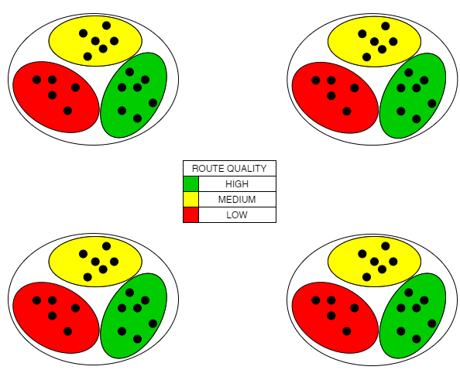
General Approach
2-stage classification (Limited Hierarchical)
Stage 1: Unsupervised classification model
Lots of features
Categorize "pre-conditions"
Stage 2: Supervised classification model
Response variable: route quality (High, Medium, Low)

Slide 11
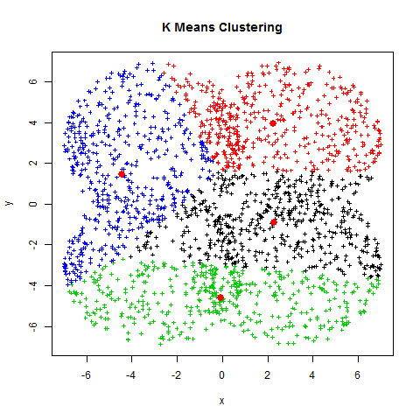
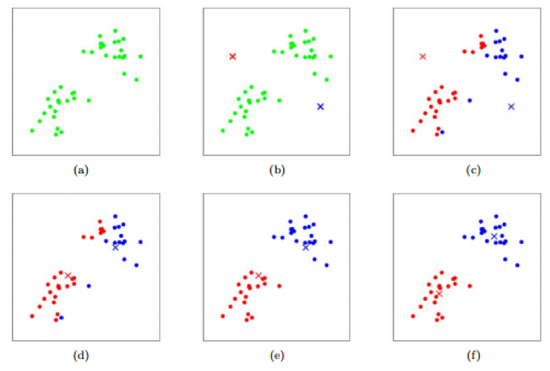
Stage 1: K-Means Clustering
Unsupervised
Repeat for different k values
Pick the best
https://www.kdnuggets.com/2017/06/machine-learning-algorithms-used-self-driving-cars.html
https://rossfarrelly.blogspot.com/2012/12/k-means-clustering.html

Slide 12
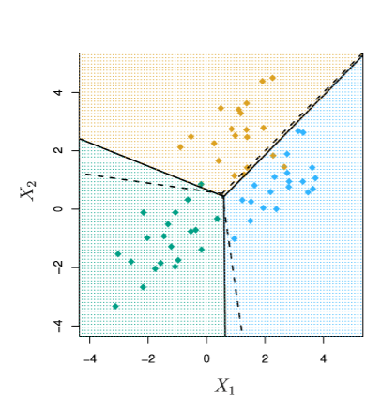
Stage 2: Linear Discriminate Analysis
Supervised high/med/low
Like logistic regression, both predict P(Y|X)
Log Reg falls apart if the classes are too separated
LDA learns prediction for P(X|Y)
Bayes' theorem yields P(Y|X)
X := an input datum
Y:= high/med/low quality
https://napsterinblue.github.io/notes/machine_learning/classification/discriminant_analysis/

Slide 13
Questions?

